Slide 1



Periodic Wind Disturbance Rejection using Robust Individual Control Strategy
Yuan Yuan, X. Chen, J. Tang
Mar 5, 2018
Department of Mechanical Engineering
University of Connecticut
Storrs, CT, USA
Photo by NREL

Slide 2
Outline
Background
Motivation
Proposed Robust Control Method
Results
Concluding Remarks

Slide 3
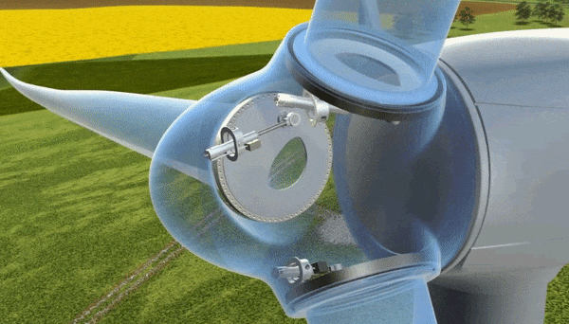
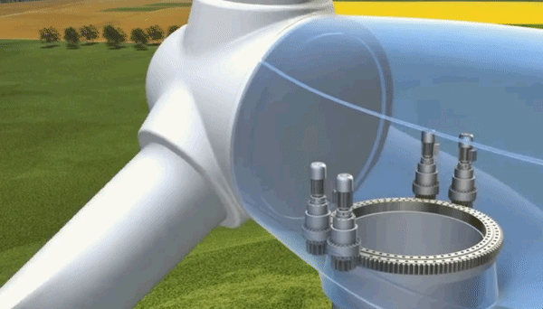
Background: Wind Turbine and Control
Wind Energy
Fastest growing renewable energy source in the world: The worldwide wind capacity reached over 400,000 MW by the end of 2015
Low cost & environmentally friendly
Pitch control animation
Wind turbine control loops
Generator torque control
Blade pitch control
Nacelle yaw control
Yaw control animation
Notes:
It is well known that wind energy is the fastest ….
It is also low cost
One important aspect of wind turbine is the control system. Let us look at the control mechanism of a typical wind turbine
The blade has a lot of airfoil cross-sections consisting of different sizes and shapes from the root to tip, the simple airfoil technology makes the wind turbine blade turn, a lift force is produced when a fluid moves over an airfoil.
The wind turbine blades typically turn at a very low speed due to the noise and mechanical strength, considering this low speed rotation we canot produce any meaning electricity frequency from the generator. So before connecting to the generator, the speed is increased in a gearbox.
There are 3 separate loops here. The first one is ….
In this research I focus on … which are most commonly studied in high wind speeds
//generator change the frequncey
Hydraulic pitch torque control: applying torque on the generator
Yaw: wind turbine be alligened with the wind direction

Slide 4
Outline
Background
Motivation
Proposed Robust Control Method
Concluding Remarks
Future Tasks

Slide 5
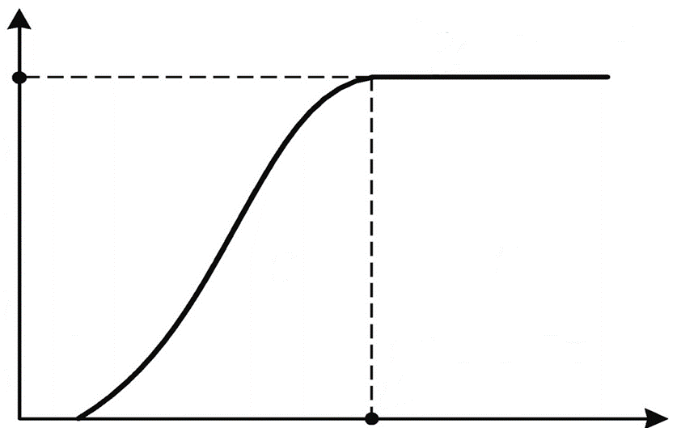
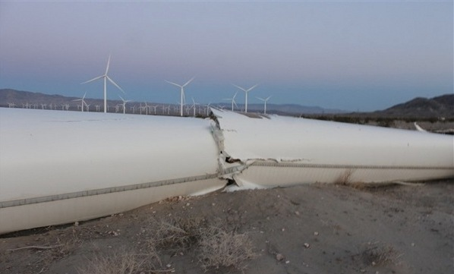

Blade pitch control
Why do we control wind turbine pitch angle?
Power regulation
Blade failure
Power(W)
3
11.4
25
Wind speed (m/s)
Collective pitch control:
All three blades move in the same angle
Regulate power and speed
Mitigate symmetric loads due to uniformly distributed wind
Collective pitch control animation

Slide 6
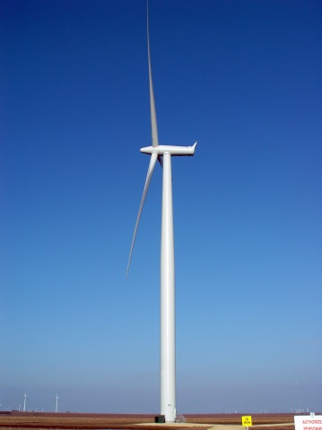
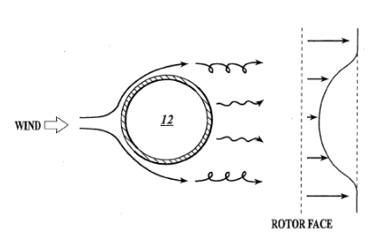
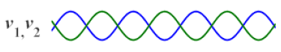
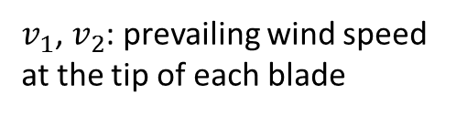
Motivation₁
Individual pitch control to mitigate periodic loads
Enabled by recent hardware advancements
Tower shadow and wind shear effects
Periodic loads
Tower shadow
Wind shear
different wind speed at different height
wind
wind
upwind turbine
downwind turbine
$v_{1}$, $v_{2}$: prevailing wind speed at the tip of each blade
Tower top
Notes:
In our previous study, we only use collective pitch control to acheive load mitigation. All blades pitch at the same angle. So only the Symmetricl loads can be reduced. But, in practical wind turbine applications, periodic loads are inevitable that need our attention.
The concept of tower shadow is illustrated in these two figures.
there is a significant difference between these situations.
In the left figure, the wind passes through blade first and then tower.
In the right figure, the wind passes through tower first and then blade. If we see from the tower top, the wind speed is decresed due to the shadow of tower in the right figure.
Wind shear means the wind speeds at different heights are different, when a blade is rotating at a plane, it actually receives the harmonic force from wind.
Therefore, the peordic loads are produced to influence the turbines.

Slide 7
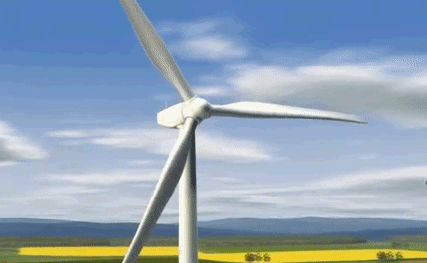
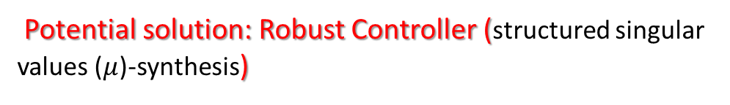
Motivation₂
Challenges for wind turbine control:
Model uncertainties
Periodic loads on blades
Coupling dynamics of 3-bladed pitch system
Objective:
Speed and power regulation in high wind speeds
Mitigate periodic loads
Robust stability and robust performance
Source: Liebherr
Difficulties in designing controller:
Operating point varies constantly – actual dynamics is different from nominal model
Potential solution: Robust Controller (structured singular values ($μ$)-synthesis)
Notes:
One potential solution is

Slide 8
Outline
Background
Research Objective
Proposed Robust Control Method
Concluding Remarks
Future Tasks

Slide 9
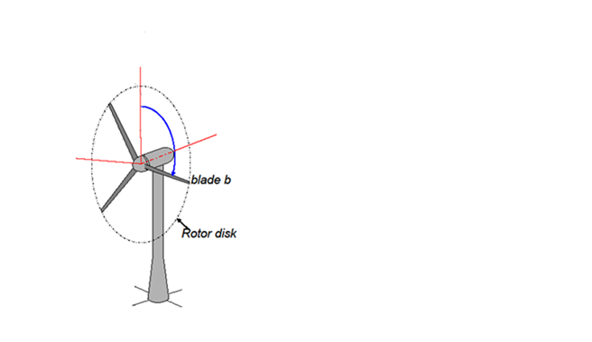
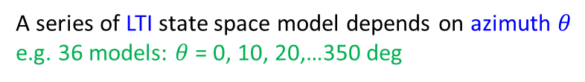
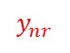
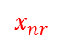
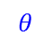
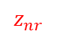
Dynamics and modeling
Modeling including periodic dynamics
$$z_{nr}$$
Steady state: blade motion is a Fourier series equation
$$θ$$
$$x_{nr}$$
linearization
Periodic LTV state space model
$$y_{nr}$$
A series of LTI state space model depends on azimuth $θ$
e.g. 36 models: $θ$ = 0, 10, 20,…350 deg
MBC transformation
transform from rotating coordinates to nonrotating coordinates
Bir, G.S., 2010. User's guide to MBC3: Multi-blade coordinate transformation code for 3-bladed wind turbine.
An average state-space system is obtained from the complete set of linearizations at N azimuth angles by computing
Notes:
The dynamics of wind turbine rotor blades are generally expressed in rotating frames attached to the
individual blades. The tower-nacelle subsystem sees the combined effect of all rotor blades, not the
individual blades. This is because the rotor responds as a whole to excitations such as aerodynamic gusts,
control inputs, and tower-nacelle motion—all of which occur in a nonrotating frame. Multi-blade
coordinate transformation (MBC) helps integrate the dynamics of individual blades and express them in a
fixed (nonrotating) frame. MBC involves two steps: transformation of the rotating degrees of freedom,
and transformation of the equations of motion.
MBC transformation can reduce the variations between linearizations obtained at different azimuths, and therefore yields a better representation of the turbine dynamics

Slide 10
Uncertain model structures
Uncertain model structure formulation
LTI state space model
Pick nominal model: 18 m/s
Challenge: wind speed changes so actual dynamics changes
Fit an uncertain model structure to an array of LTI responses :
14 m/s, 16 m/s, 20 m/s, and 22 m/s
Frequency responses comparison
Model mismatch in high frequency regions
Uncertain model structures

Slide 11
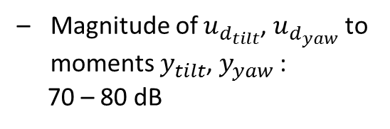
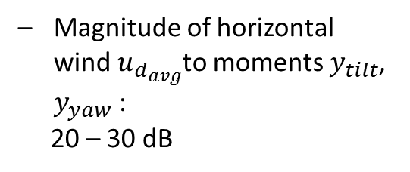
Shear components
Horizontal and vertical wind shear effects to dynamic modeling
Magnitude of $u_{d_{tilt}}$, $u_{d_{yaw}}$ to moments $y_{tilt}$, $y_{yaw}$ :
70 – 80 dB
Magnitude of horizontal wind $u_{d_{avg}}$to moments $y_{tilt}$, $y_{yaw}$ :
20 – 30 dB
Bode Diagram has large magnitude
Include wind shear components in the model

Slide 12
Control architecture formulation
Control architecture formulation
Collective loop:
Speed and power regulation
GSPI/DOB ^{[1]}
Individual loop:
Periodic load mitigation
Robust control with weighting function selection
[1] Yuan, Y., Chen, X., and Tang, J., 2017, "Disturbance Observer-Based Pitch Control of Wind Turbines for Enhanced Speed Regulation," Journal of Dynamic Systems, Measurement, and Control, V139(7), pp. 071006.
Notes:
We plan to use individual control to tracle this problem. The upper control loop is the collective loop, the lower loop is the individual loop.

Slide 13
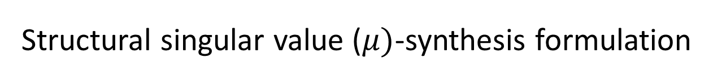

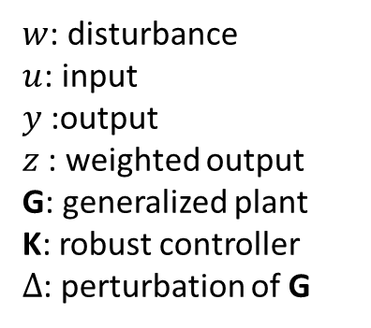
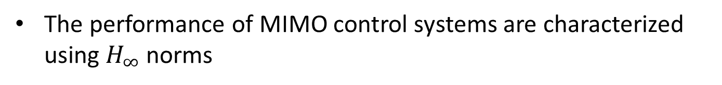
Structural singular value ($μ)$-synthesis formulation
Advantages using structural singular value-synthesis
RSRP (robust stability and robust performance) guarantee under model uncertainties due to operating point variation
Disturbance rejection via weighting function selection
M-$∆$ structure
$w$: disturbance
$u$: input
$y$:output
$z$: weighted output
G: generalized plant
K: robust controller
$∆$: perturbation of G
The performance of MIMO control systems are characterized using $H_{∞}$ norms

Slide 14
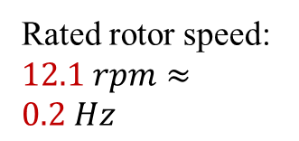
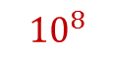
Power spectral density
Power spectral density (PSD) of blade 1 root flapwise moment with only collective loop
$${10}^{8}$$
1P
Rated rotor speed: $12.1 rpm≈0.2 Hz$
2P
3P
4P
Severe limits:
Multiple peaks at 1P (per revolution), 2P, 3P, … frequencies due to periodic loads on
Component failure

Slide 15
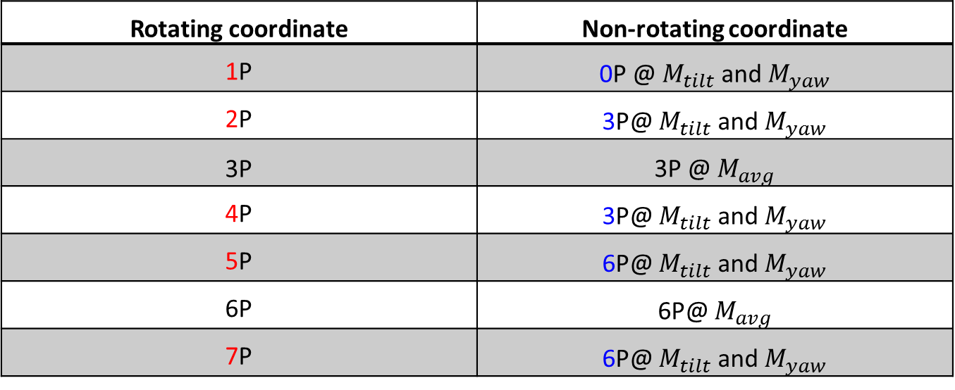
Weighting functions
Frequency effects change due to coordinates change
Rotating coordinate | Non-rotating coordinate
1P | 0P @ $M_{tilt}$ and $M_{yaw}$
2P | 3P@ $M_{tilt}$ and $M_{yaw}$
3P | 3P @ $M_{avg}$
4P | 3P@ $M_{tilt}$ and $M_{yaw}$
5P | 6P@ $M_{tilt}$ and $M_{yaw}$
6P | 6P@ $M_{avg}$
7P | 6P@ $M_{tilt}$ and $M_{yaw}$
Sensitivity function
Minimize the norm
Further penalize the control input and output performance

Slide 16
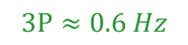
Weighting functions
Select weighting functions
low pass filter
$$3P≈0.6 Hz$$
low frequency

Slide 17
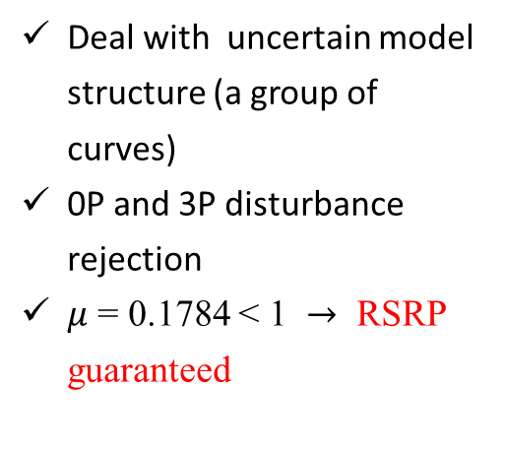
Singular values
Multivariate transfer functions: singular values of transfer function
Open-loop and closed-loop responses of the nonlinear wind turbine under turbulent wind excitations
Deal with uncertain model structure (a group of curves)
0P and 3P disturbance rejection
$μ$ = 0.1784 < 1 $→$ RSRP guaranteed
Notes:
The shaping of multivariate transfer functions is based on the idea that a satisfactory definition of gain for a matrix transfer function is given by the singular values of the transfer function

Slide 18
Outline
Background
Research Objective
Proposed Robust Control Method
Concluding Remarks
Future Tasks

Slide 19
PSD results
PSD result analysis at multiple frequencies
18 m/s turbulent wind field excitation
Significant 1P, 2P, and 4P peak reduction

Slide 20
Load analysis
Blade and tower fatigue damage equivalent load (DEL) comparison
(DEL: industrial standard)
Collective control
PID individual control
Robust individual control
Blade flapwise: Robust: -20% of PID
Blade edgewise: same level
Tower base fore-aft: 3%-10% decrease
Tower base side-side: same level

Slide 21
Concluding remarks
A robust controller with mu synthesis for wind turbine is developed;
Individual pitch control is utilized to reject periodic loads;
Robust control strategy is formulated to tackle with modeling uncertainties;
Periodic loads on blades are significantly reduced.

